Slide 1
国际金融专题
杜涣程

Slide 2

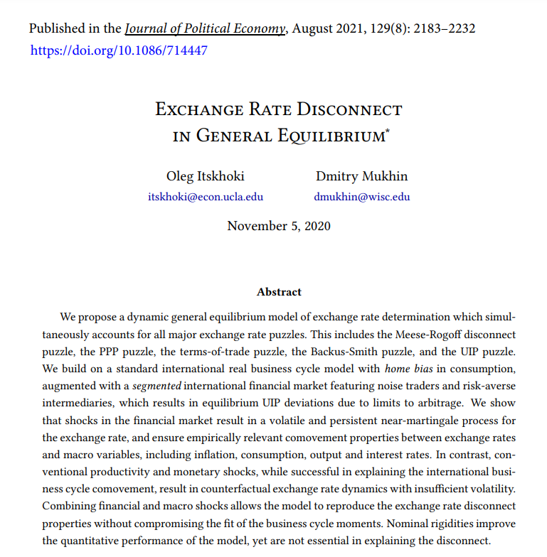

Slide 3
汇率断连 (Exchange Rate Disconnect)
狭义的汇率断连
具体指汇率与其他宏观经济变量（通胀率、国内生产总值、进出口贸易额、失业率等等）缺乏相关性
广义的汇率断连
Meese and Rogoff (1983) puzzle
购买力平价(Purchasing Power Parity, PPP) 之谜
贸易条件(Terms-of-Trade, ToT)之谜
Backus and Smith (1993) puzzle
远期汇水(Forward premium)之谜
无抛补利率平价(Uncovered Interest rate Parity, UIP) 失效

Slide 4
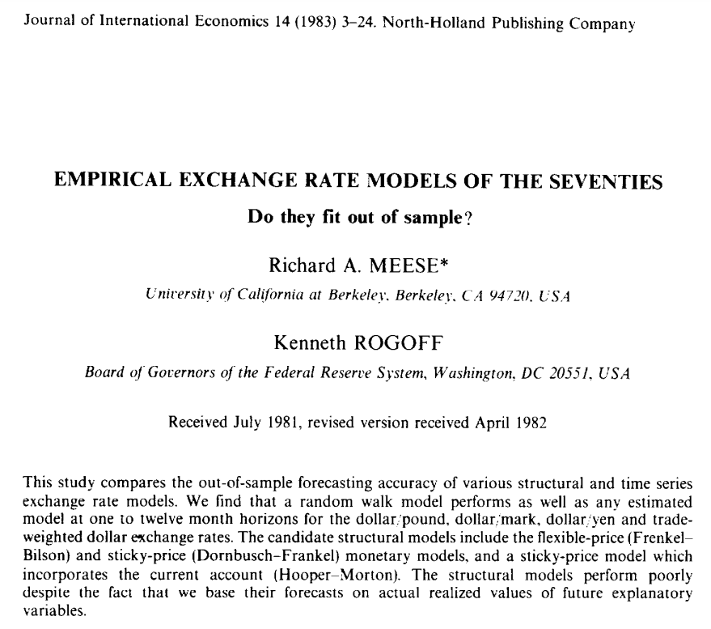
Meese and Rogoff (1983) Puzzle

Slide 5
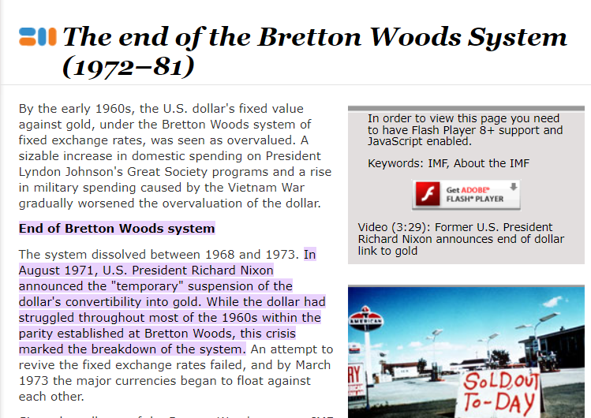
The Monetary Theory of The Exchange Rate （基于货币政策理论的汇率决定理论）
布雷顿森林体系
二战以后
解决混乱的汇率问题
双挂钩机制
美国持有3/4黄金
越南战争导致美元严重高估
体系在1968-1973年间瓦解

Slide 6
The Monetary Theory of The Exchange Rate : 三大要素（假设）
利率平价理论 (Interest Rate Parity)
购买力平价理论 (Purchasing Power Parity)
货币市场均衡——玩具类模型 (Money Market - Toy Model)
货币数量理论 (Quantity Theory of Money)

Slide 7
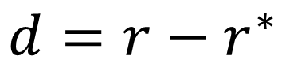
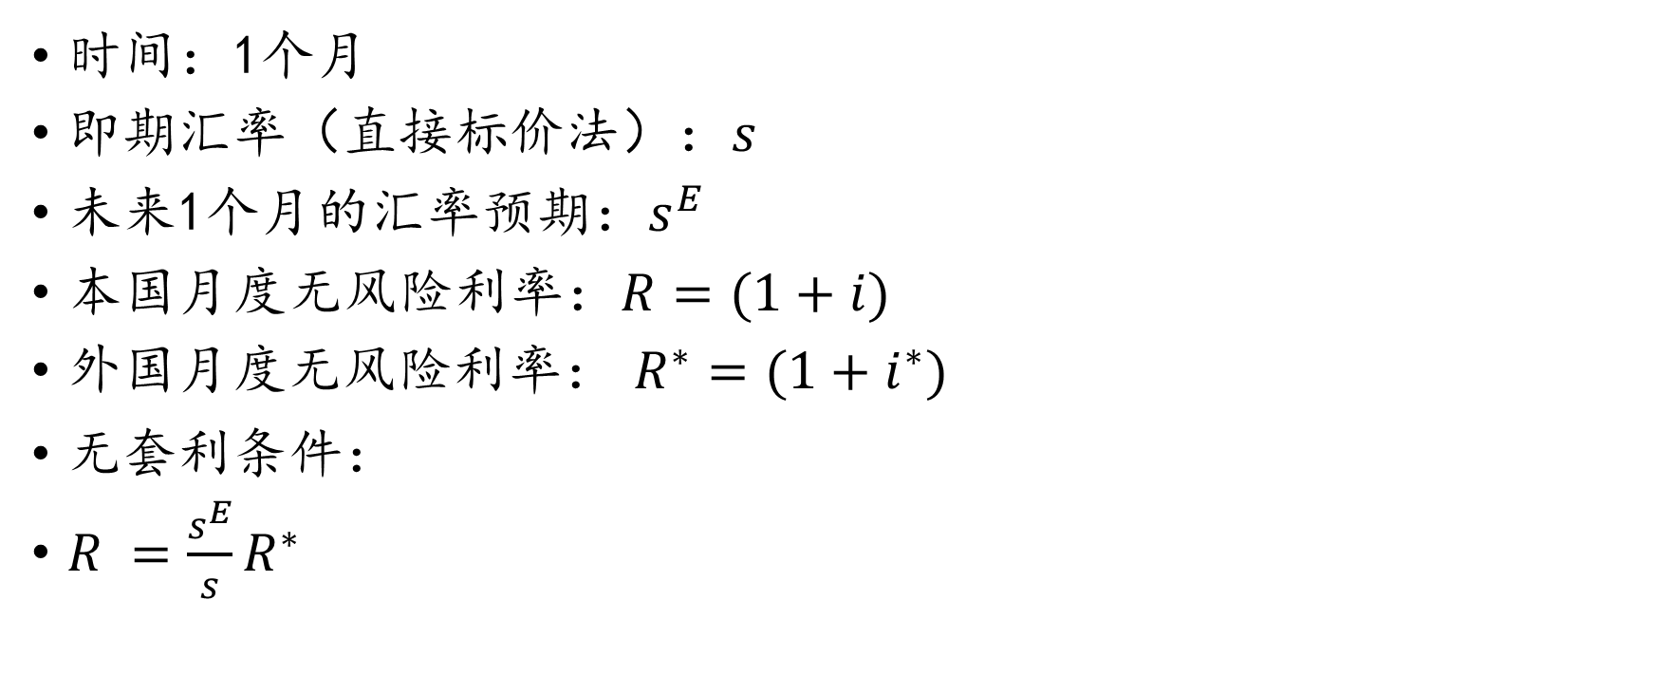
利率平价理论：简单解析
时间：1个月
即期汇率（直接标价法）：$s$
未来1个月的汇率预期：$s^{E}$
本国月度无风险利率：$R=(1+i)$
外国月度无风险利率： $R^{∗}=(1+i^{∗})$
无套利条件：
$R =\frac{s^{E}}{s}R^{∗}$
$$d=r−r^{∗}$$

Slide 8



购买力平价理论：简单解析
$$=?$$

Slide 9
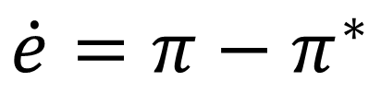
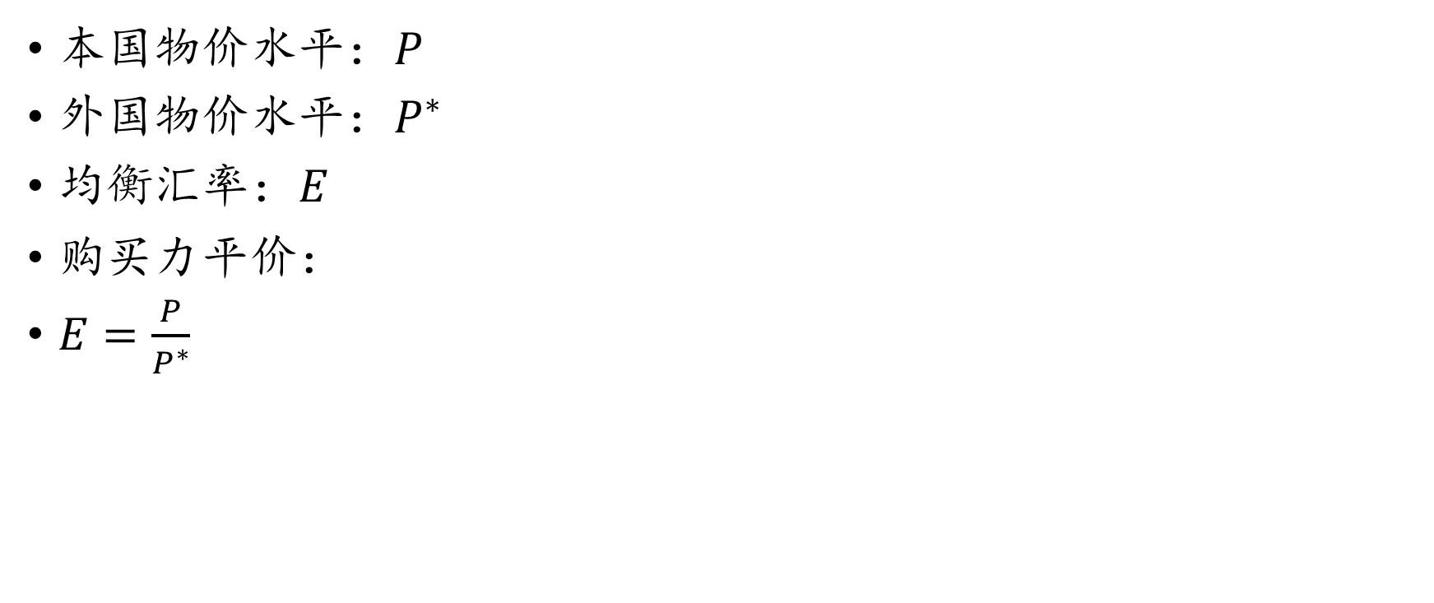
购买力平价理论：简单解析
本国物价水平：$P$
外国物价水平：$P^{∗}$
均衡汇率：$E$
购买力平价：
$E=\frac{P}{P^{∗}}$
$$\dot{e}=π−π^{∗}$$

Slide 10
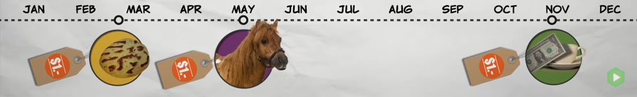
货币数量理论简析

Slide 11


货币数量理论简析

Slide 12


Slide 13
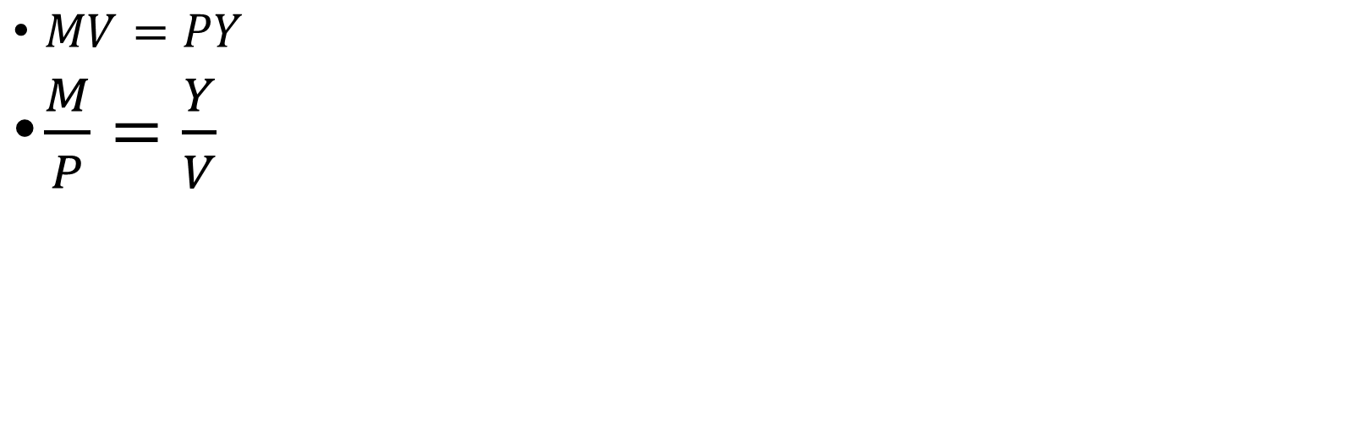
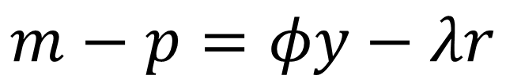
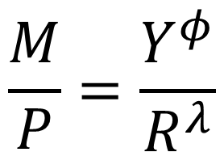
$MV=PY$
$\frac{M}{P}=\frac{Y}{V}$
$$\frac{M}{P}=\frac{Y^{φ}}{R^{λ}}$$
$$m−p=φy−λr$$

Slide 14
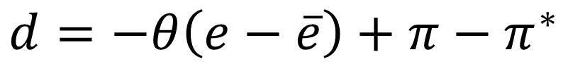
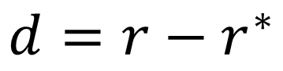
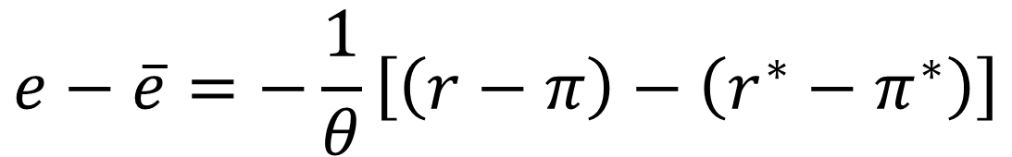
The Monetary Theory of The Exchange Rate
利率平价理论
长期:购买力平价理论
短期:汇率呈现均值回归 (Mean Reversion)
符合上述条件的汇率：
$$d=r−r^{∗}$$
$$d=−θ\left(e−\overline{e}\right)+π−π^{∗}$$
$$e−\overline{e}=−\frac{1}{θ}\left[\left(r−π\right)−\left(r^{∗}−π^{∗}\right)\right]$$

Slide 15
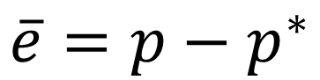

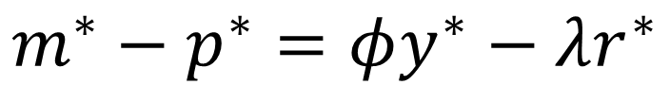
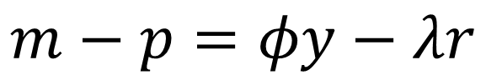
什么决定了长期均衡的$\overline{e} ?$
购买力平价理论：
货币市场均衡：
两国物价的变化取决于两国货币政策
$$\overline{e}=p−p^{∗}$$
$$m−p=φy−λr$$
$$m^{∗}−p^{∗}=φy^{∗}−λr^{∗}$$
$$\overline{e}=p−p^{∗}=m−m^{∗}−φ\left(y−y^{∗}\right)+λ\left(r−r^{∗}\right)$$
$$\overline{e}=m−m^{∗}−φ\left(y−y^{∗}\right)+λ\left(π−π^{∗}\right)$$

Slide 16
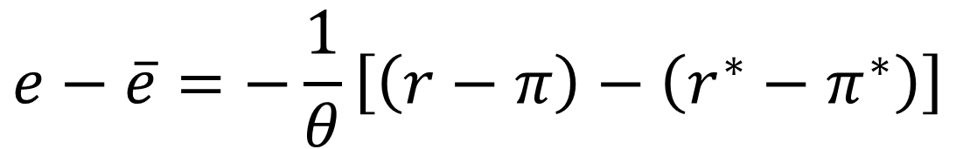
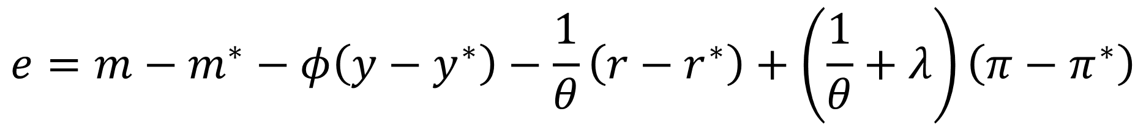
The Monetary Theory of The Exchange Rate
$$e−\overline{e}=−\frac{1}{θ}\left[\left(r−π\right)−\left(r^{∗}−π^{∗}\right)\right]$$
短期：
长期：
$$\overline{e}=m−m^{∗}−φ\left(y−y^{∗}\right)+λ\left(π−π^{∗}\right)$$
$$e=m−m^{∗}−φ\left(y−y^{∗}\right)−\frac{1}{θ}\left(r−r^{∗}\right)+\left(\frac{1}{θ}+λ\right)\left(π−π^{∗}\right)$$

Slide 17
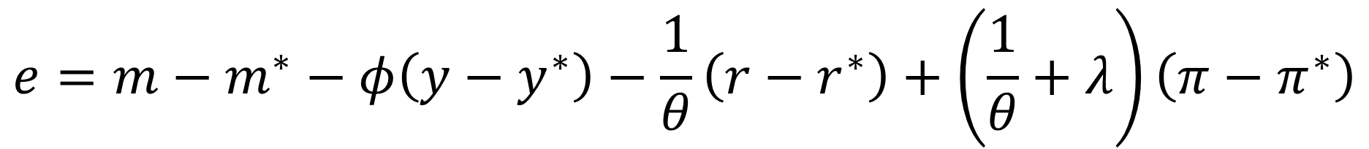
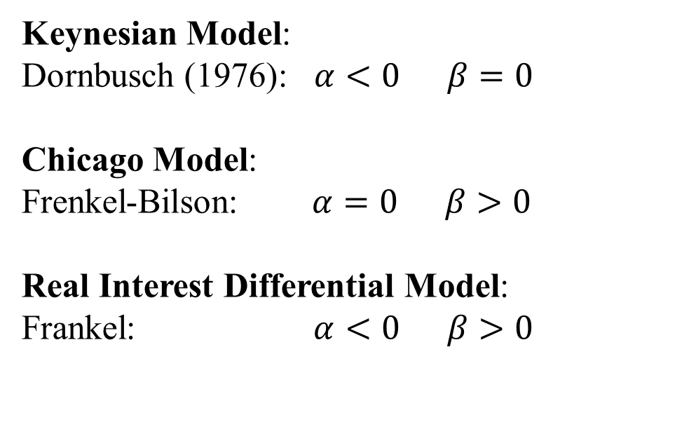
货币政策理论汇率决定的实证测量
$$e=m−m^{∗}−φ\left(y−y^{∗}\right)−\frac{1}{θ}\left(r−r^{∗}\right)+\left(\frac{1}{θ}+λ\right)\left(π−π^{∗}\right)$$
$$e=m−m^{∗}−φ\left(y−y^{∗}\right)+α\left(r−r^{∗}\right)+β\left(π−π^{∗}\right)+μ$$
Keynesian Model:
Dornbusch (1976): $α<0 β=0$
Chicago Model:
Frenkel-Bilson: $α=0 β>0$
Real Interest Differential Model:
Frankel: $α<0 β>0$

Slide 18
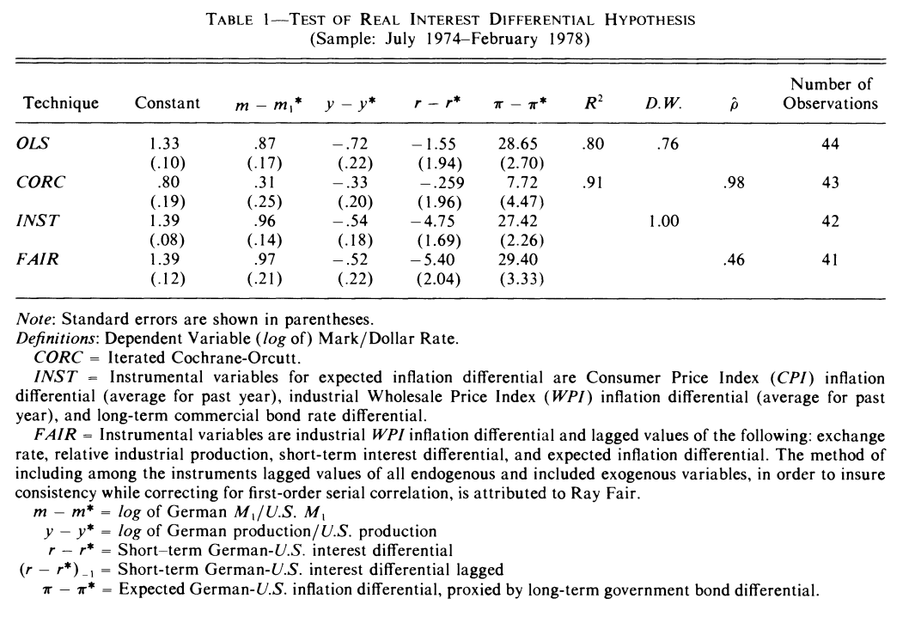

Slide 19
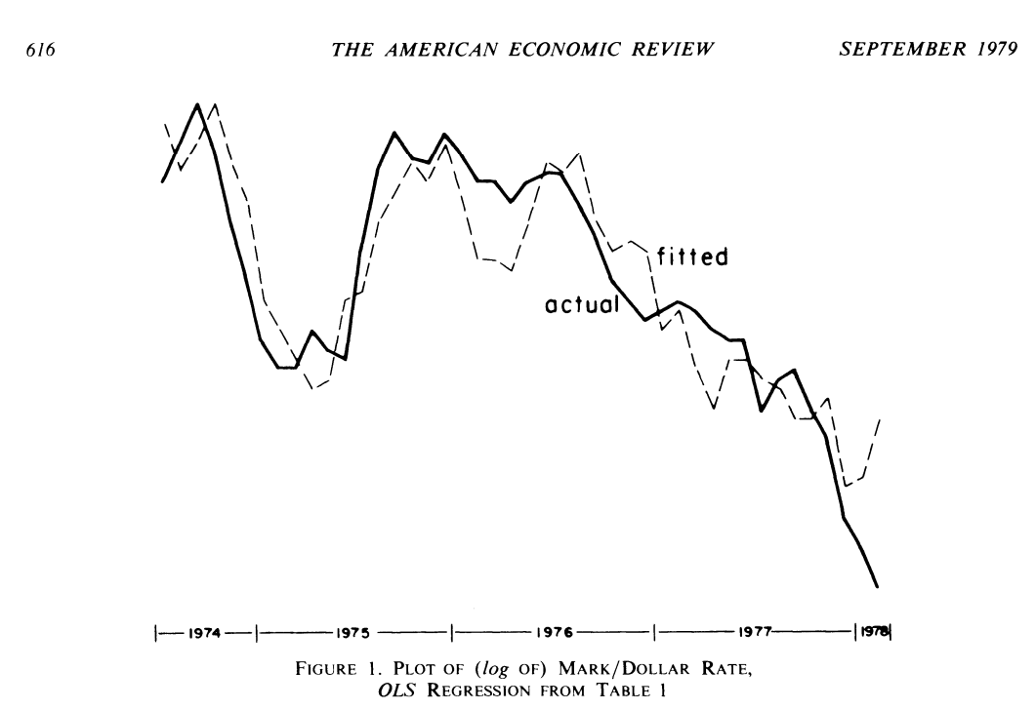

Slide 20
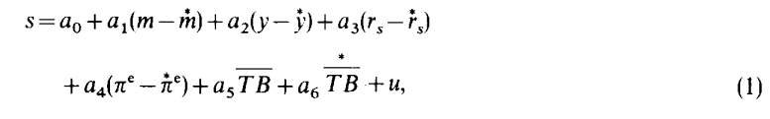
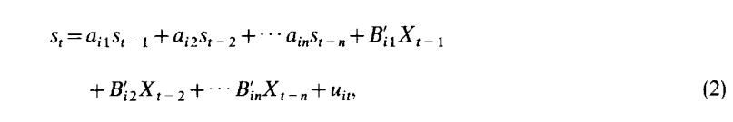
Meese and Rogoff (1983)
样本外(Out of Sample)
预测能力：
滚动回归 (Rolling-Regression)
月度数据，March, 1973
November, 1976
(2) Forecast future 1m, 3m, 6m, 12m
(3) Add true November, 1976 data
(4) Forecast future 1m, 3m, 6m, 12m
(5) Add true December, 1976 data
…..
计算每个 forecast 与 真实值的 root mean squared error

Slide 21
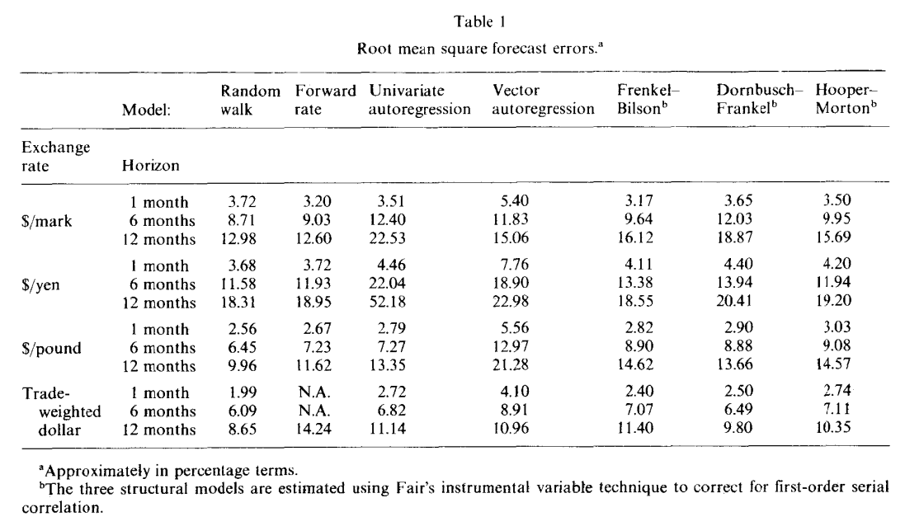
Meese and Rogoff (1983) Puzzle

Slide 22
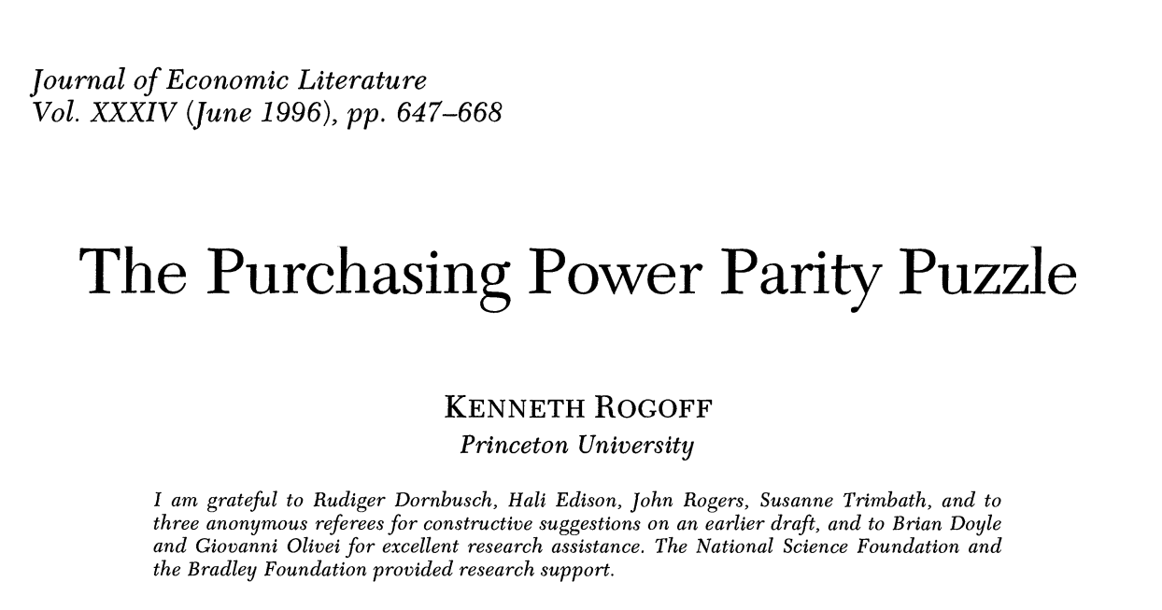

Slide 23
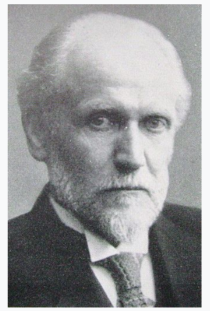
Origin of Purchasing Power Parity
一战之前金本位
一战之后：
重置汇率
金本位不现实
汇率如何修复？
从1914年开始计算各国累计通胀率
汇率变化程度符合通胀率变化程度
Gustav Cassel
1866.10 ——1945.01
瑞典经济学家

Slide 24
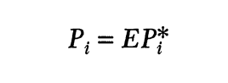
Law of One Price (LOP)
对于同一类商品，只有一个价格
Transportation Cost
Tariff
Nontariff barrier
Tradability of goods

Slide 25
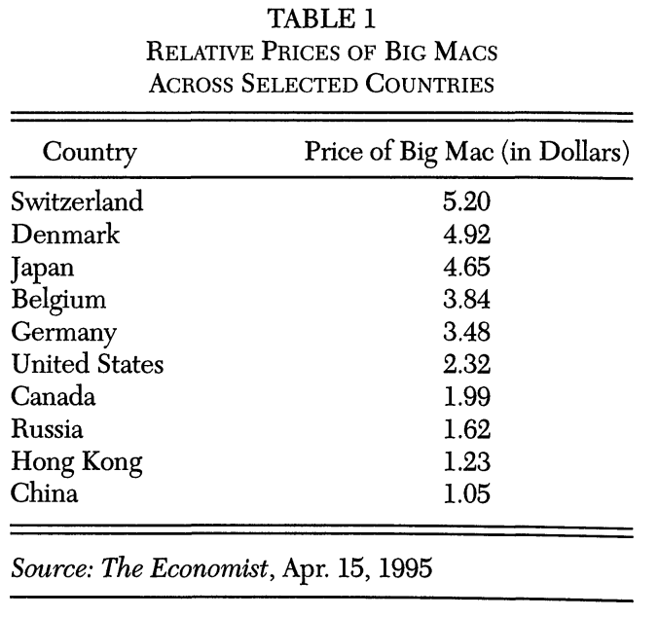
“Big Mac” AGAIN
Do not transport very well in their final form!
Tradable components:
Frozen beef patty （冷冻牛肉饼）
Buns （面包夹层）
Special sauce ingredients （特殊酱料）
Non-tradable components:
Restaurants location/space
Labor inputs needed to cook and serve

Slide 26
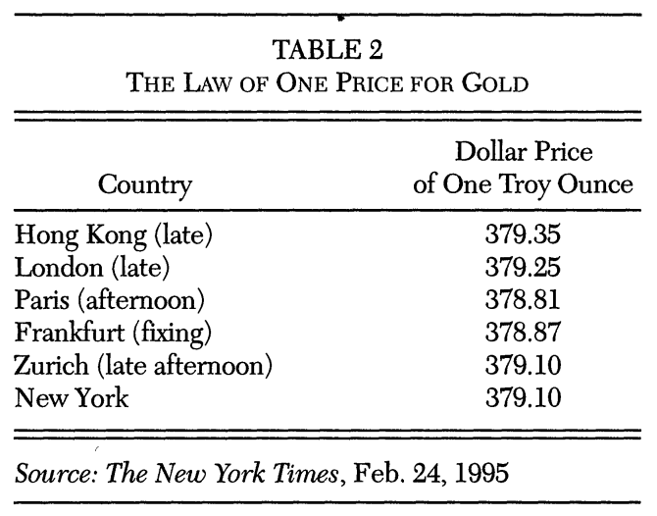
What about GOLD? (highly tradable)

Slide 27
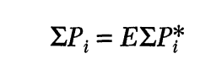
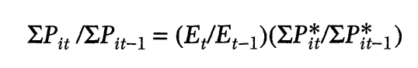
Two Other Forms of PPP
Absolute PPP
Relative PPP

Slide 28
Empirical Evidence of LOP
Peter Isard (1977): US, German, Canadian, Japanese
Highly tradable goods:
服装、工业化学物品、纸张、玻璃制品
LOP的偏离度：
偏离程度大
持续久
基本反应名义汇率的变化
Alberto Giovannini (1988)
价格差距非常大、并且统计显著
普通生产工具：螺丝钉、螺丝帽

Slide 29
International vs. Intra-National
上述价格不等的实证发现
可能只是距离原因
类似于同种商品，不同城市，甚至不同商店同城市
Charles Engel and Rogers (1995)
14 categories of disaggregated CPI data
23 cities for U.S. and Canada
一国内，相对价格是地理距离的方程
控制住地理距离：
看边境两侧城市的相对价格
“边境效应”(Border Effect)
2,500 to 23,000 英里！！！
Engel (1993)
同样商品跨境的相对价格
不同商品非跨境的相对价格

Slide 30
Possible Frictions: Why it is not arbitraged away??
Transportation Costs:
离岸价 (Free on Board)
到岸价 (Cost Insurance and Freight)
IMF: 10%
Non-tradable components:
Location rents
Services, taxes, insurance
Tariff
Nontariff barriers
Long time goods inspections
Impossible to arbitrage:
电压使用标准（220V）
左舵汽车

Slide 31
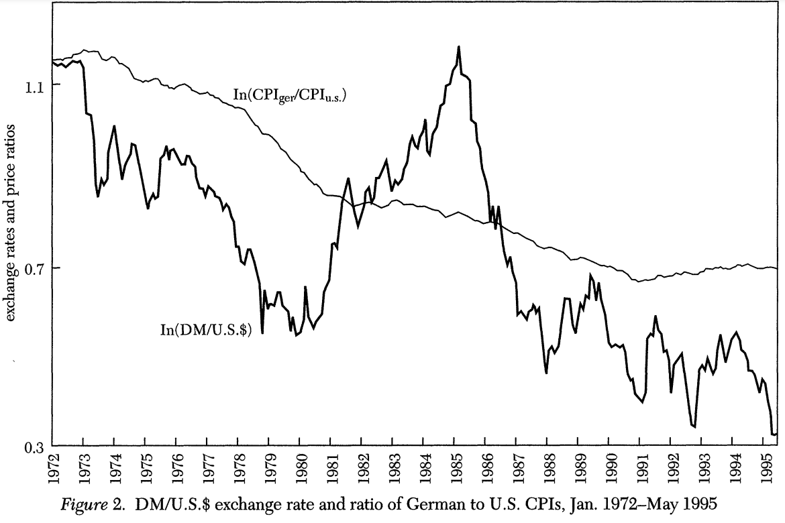
Short-run PPP Deviation

Slide 32
Interpretation on the short-run PPP violation
Attributed to sticky nominal prices
Monetary and financial shocks
Have real effect due to sticky nominal prices （价格粘性）
Dornbusch (1976) Overshooting model
Substantial convergence to PPP over 1 to 2 years
Prices and wages adjust to shocks
Embarrassing Resiliency of the Random Walk Model

Slide 33
Tests Based on Long-horizon data
Frankel (1986, 1990)
Lack of statistical power
Dollar/Pound exchange rate for 1869-1984
Decay for real exchange rate deviations of 14% per year
Roughly 4.6 years for 50%
Niso Abuaf and Phillipe Jorion (1990)
Eight currencies, 1901-1972
3.3 years
James R. Lothian and Mark P. Taylor
Dollar/Pound (1791-1990): 4.7 years
Franc/Pound (1803-1990): 2.5 years

Slide 34
Balassa-Samuelson Hypothesis
Balassa (1964) and Samuelson (1964)
将两个国家的名义货币同时按照即期汇率兑换成第三种币种时
富有国家的价格水平（用第三种货币计量） 往往 高于 贫穷国家的价格水平（用第三种货币计量）
为什么？
并不是因为富有国家比贫穷国家的平均生产效率高

Slide 35
Balassa-Samuelson Hypothesis
Balassa (1964) and Samuelson (1964)
将两个国家的名义货币同时按照即期汇率兑换成第三种币种时
富有国家的价格水平（用第三种货币计量） 往往 高于 贫穷国家的价格水平（用第三种货币计量）
为什么？
并不是因为富有国家比贫穷国家的平均生产效率高
根源：
富有国家的 Tradable sector is more productive than Non-tradable sector
What will happen if there is a rise in productivity in the tradable goods sector?
Small open economy
Tradable goods sector: globally competitive market

Slide 36
Kravis and Robert Lipsey (1983) Jagdish Bhagwati (1984)
Factor Endowment Perspective
Capital Labor Ratio
Higher in richer countries
Lower in poorer countries
Rationale

Slide 37
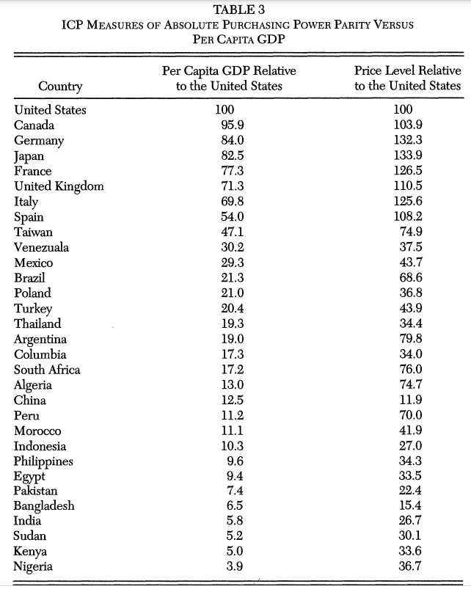

Slide 38
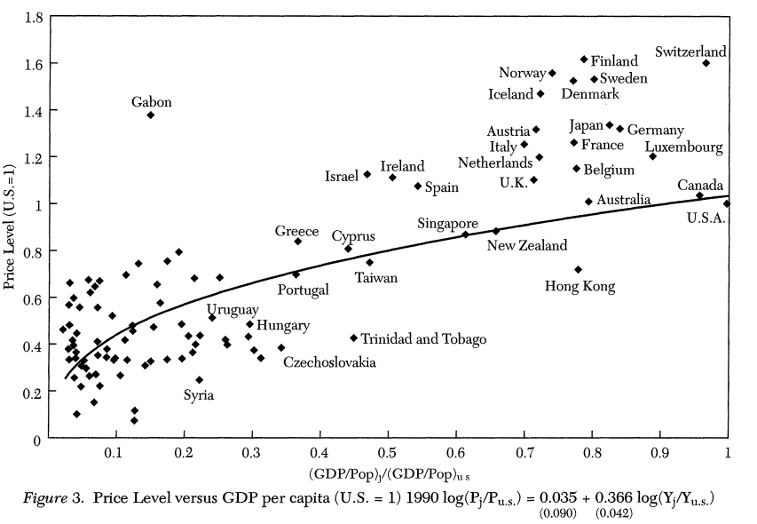

Slide 39
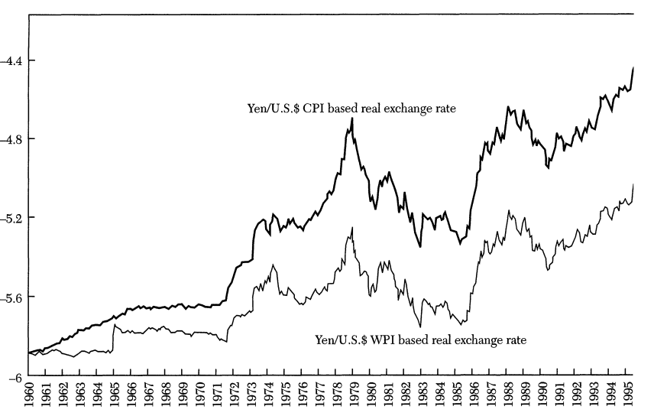
Another Balassa-Samuelson Hypothesis
Fast-growing countries vs. slow-growing countries
Growth mostly happened in tradable goods sector

Slide 40
Purchasing Power Parity Puzzle
PPP do not hold in the short-run
Convergence to PPP is extremely slow (3-to-5 years, 50%)
Explanation of short-term exchange rate volatility
Monetary and Financial shocks
Real shocks to productivity and preferences
Impossible to explain immense short-term volatility
If majority of the volatility is due to financial shocks
Why 3-to-5 years???

